Slide 1

MS Project Exporting Tracking Data
Build Track Communicate
Electrical Engineering Systems
Dublin Institute of Technology

Slide 2
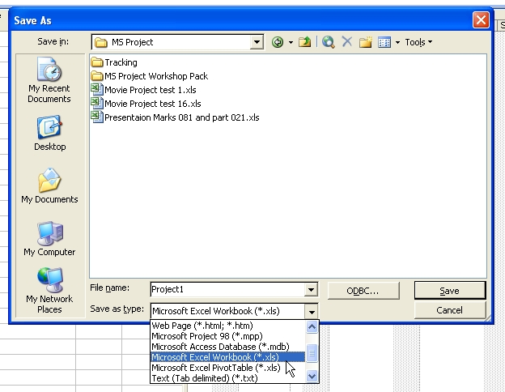
Select all Tasks in the MS Project file
File – Save As – Select MS Workbook

Slide 3
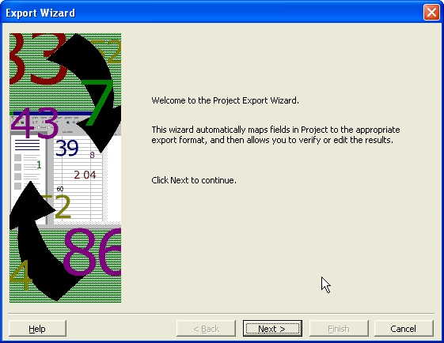
The Data Export Wizard now appears on the screen
Click Next

Slide 4
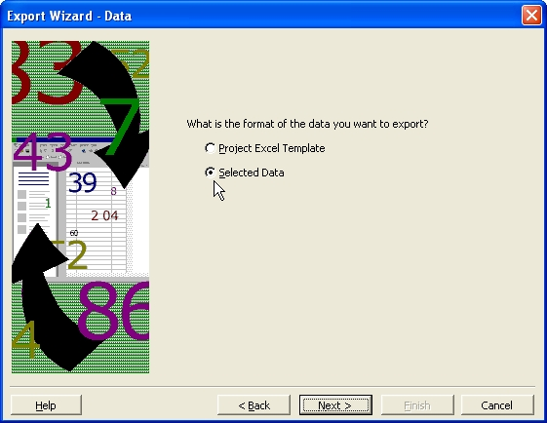
Select “Selected Data”
Select “Next”

Slide 5
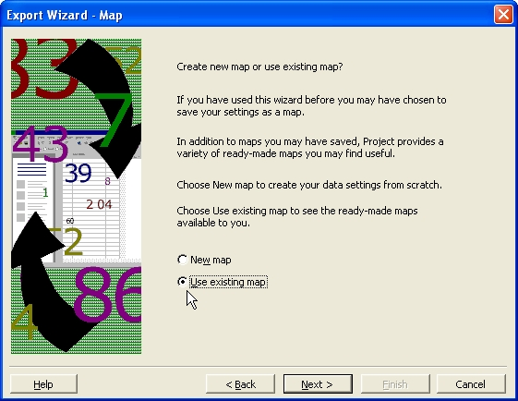
Select “Use Existing Map”
Click Next

Slide 6
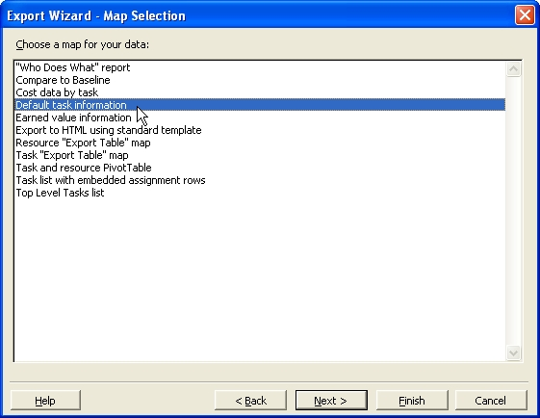
Select “Default task information”
Click Next

Slide 7
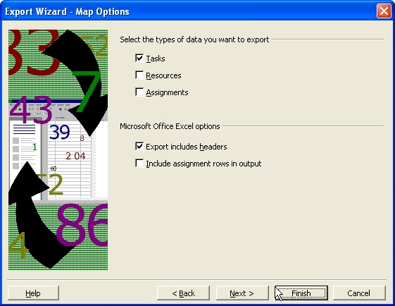
Select “Tasks” and “Export includes headers”
Click Next

Slide 8
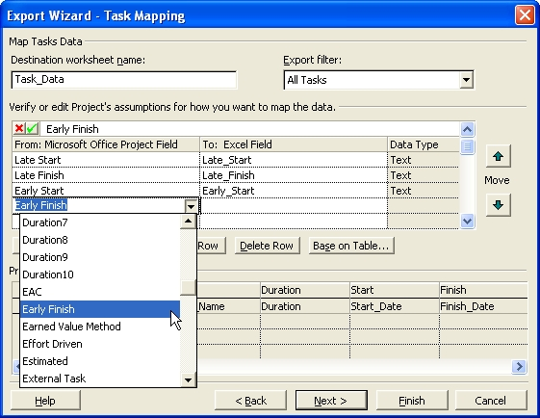
Adding Extra Fields to the Export
Here I have added Late Start, Early Start and Late Finish and I am about to ass an Early Finish field also

Slide 9
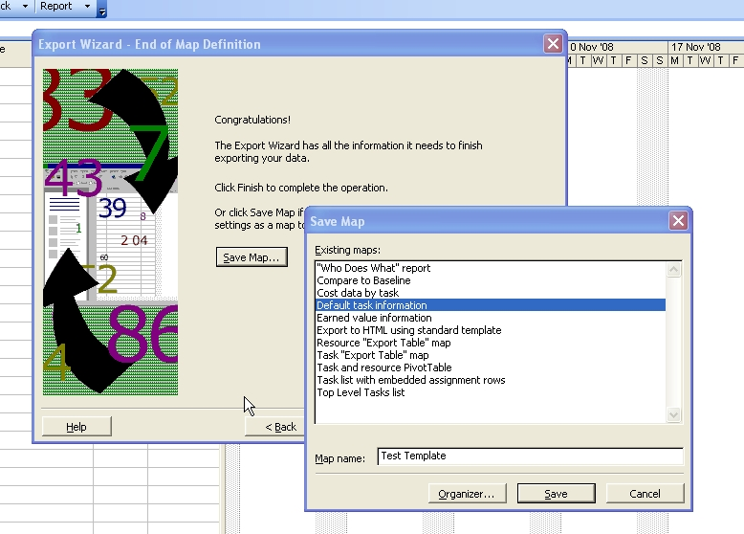
Saving the mapped fields
Give your map a unique name and then save

